Slide 1
North IDE – Simulator Instructional Guide
Prepared By: Sanil Singh

Slide 2

Getting Started
Before getting started, its important to understand the background information
IDE: Thonny (Open Source Platform)
Language: Python

Slide 3
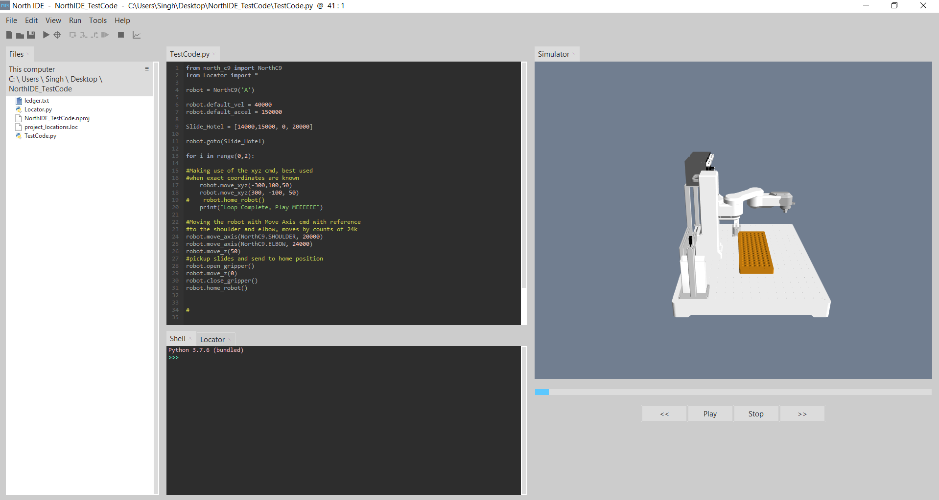
North IDE Overview
5
File Explorer
Python Shell (Output box)
Locator Table
Input Area
Simulate/Run
Simulator
6
4
1
3
2

Slide 4
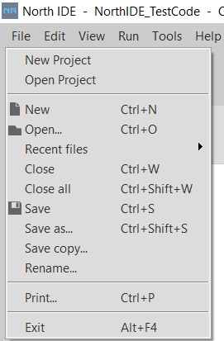
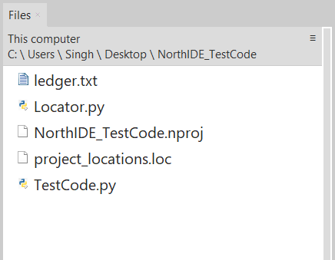
Creating a New Project/File
Create a New Project
Note: Save to an easily accessible location. Ex Desktop
Create a New File
Ensure the File is within the NEW project
Go To “Files”
Direct this window to the location of your project & file

Slide 5
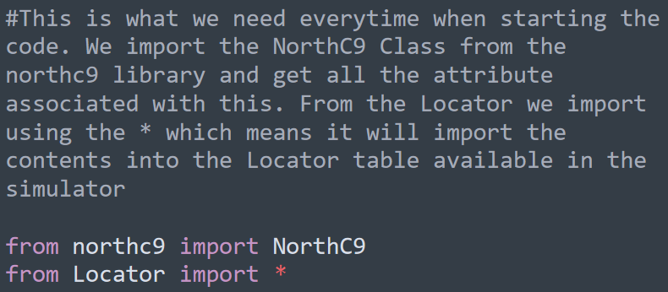
Getting Started with Programming
Before programming, ensure the following:
Import North C9 Library
Get Contents from Locator Table

Slide 6
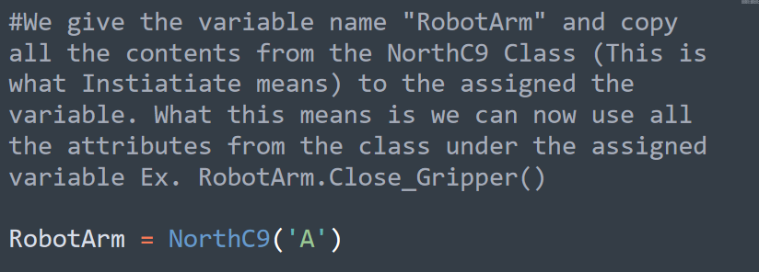
Instantiating Variables
Assign all the contents from the NorthC9 Class to your variable

Slide 7
How does the Robot move?
The Robot can move through 2 ways
Rotational Counts (Range 0 – 24000)
Radians
The Robot utilizes the XYZ planes to move to specific location
Can also utilize the coordinate system when moving with XYZ commands

Slide 8
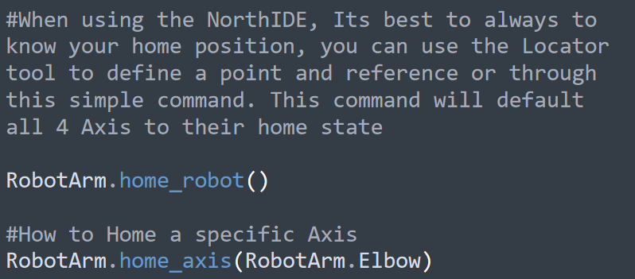
“Homing” the Robot
It is very important to know how to Home the Robot

Slide 9
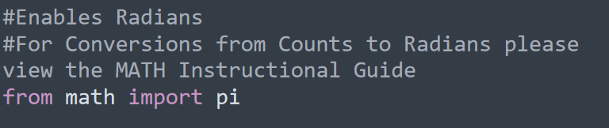
Moving the Robot – Math Integration

Slide 10
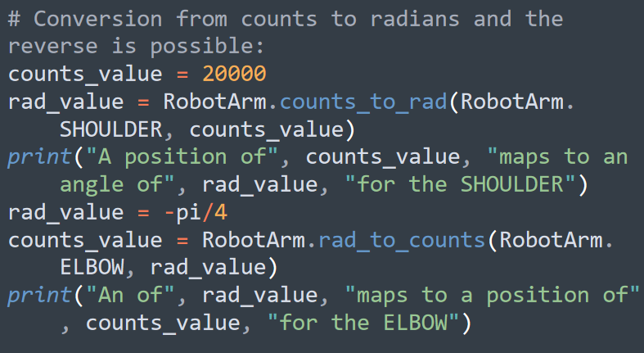
Math Integration – Radians & Counts

Slide 11
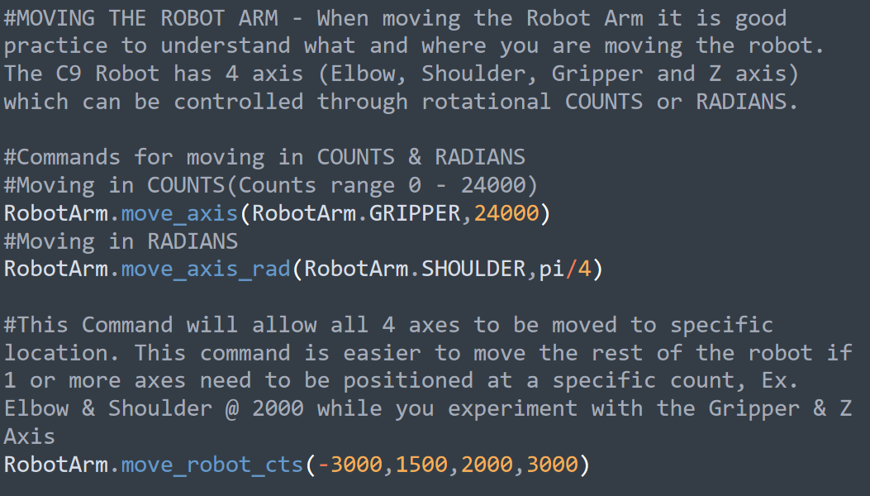
Moving the Robot – Counts & Radians
Moving through Counts & Radians

Slide 12
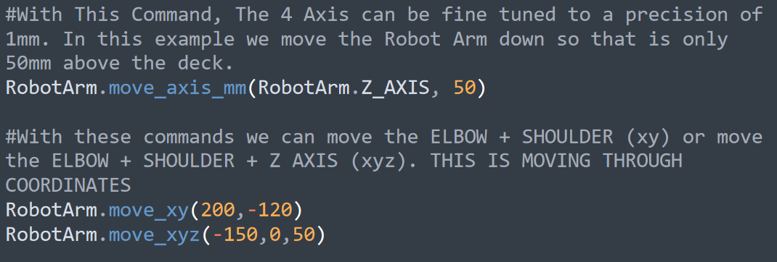
Other ways to move the Robot – Axis Control
Moving the Robot Arm through specific axis

Slide 13
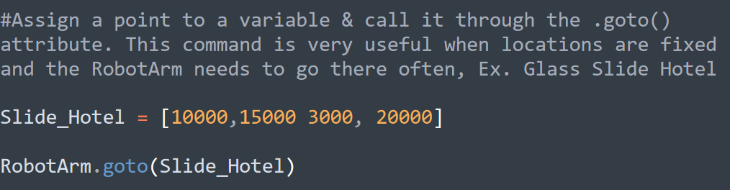
Moving the Robot – Defined Movement
Define a point using Counts/Radians and move the robot accordingly

Slide 14
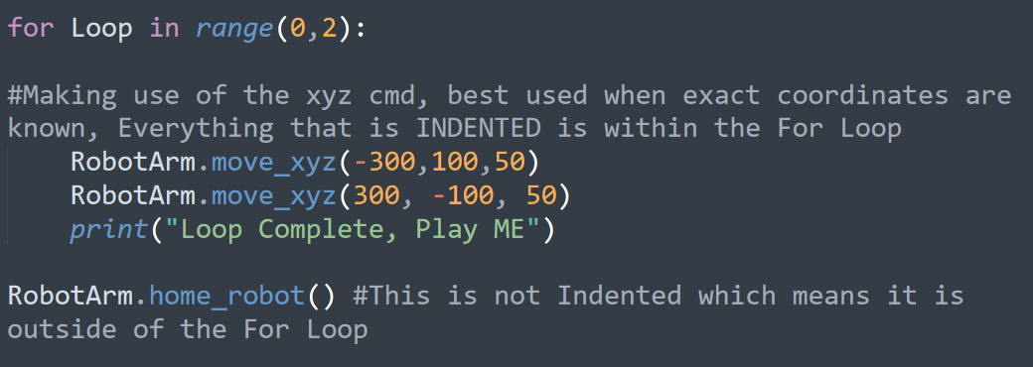
Moving the Robot - Loops
Make use of Loops to reduce code when repeating tasks

Slide 15
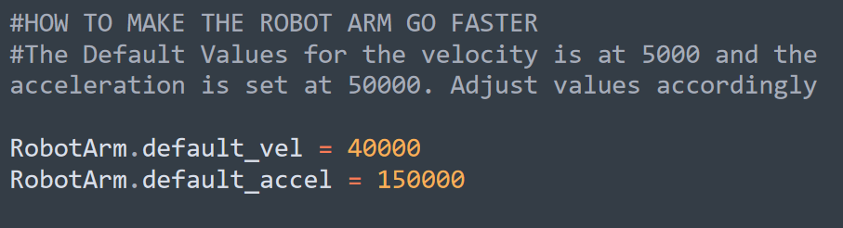
Increasing the Robot Speed
Increasing/Decreasing to customize robot speed for users specifications

